Slide 1

We do Analytics Very Well!
EcoEat
Inset your subtitle here. This is a good space for a short subtitle
Notes:
Note: Click on the “Picture Place Holder”, then send the picture back to get the black creamy effect.

Slide 2



USA Average Foodprint
28.6
Tons of annual CO2 emission per typical American
83%
80%
Of all water consumed in US is for agriculture
Of total worldwide emissions accounted by food

Slide 3
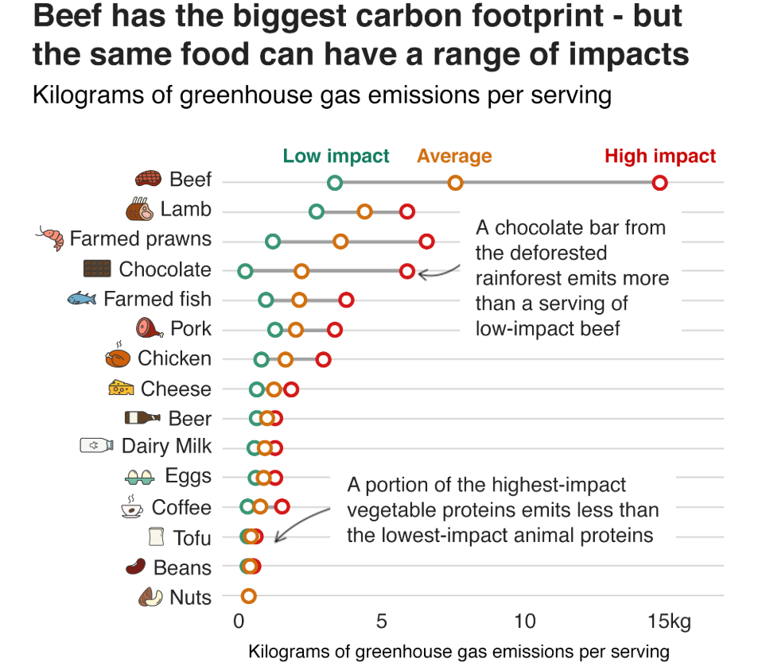
Beef and chicken are both proteins, but consuming beef will increase emission amount by
547%

Slide 4

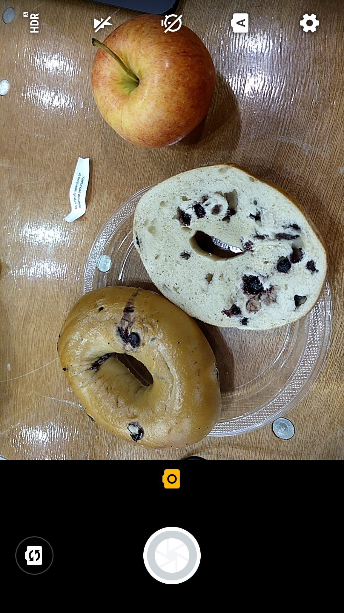
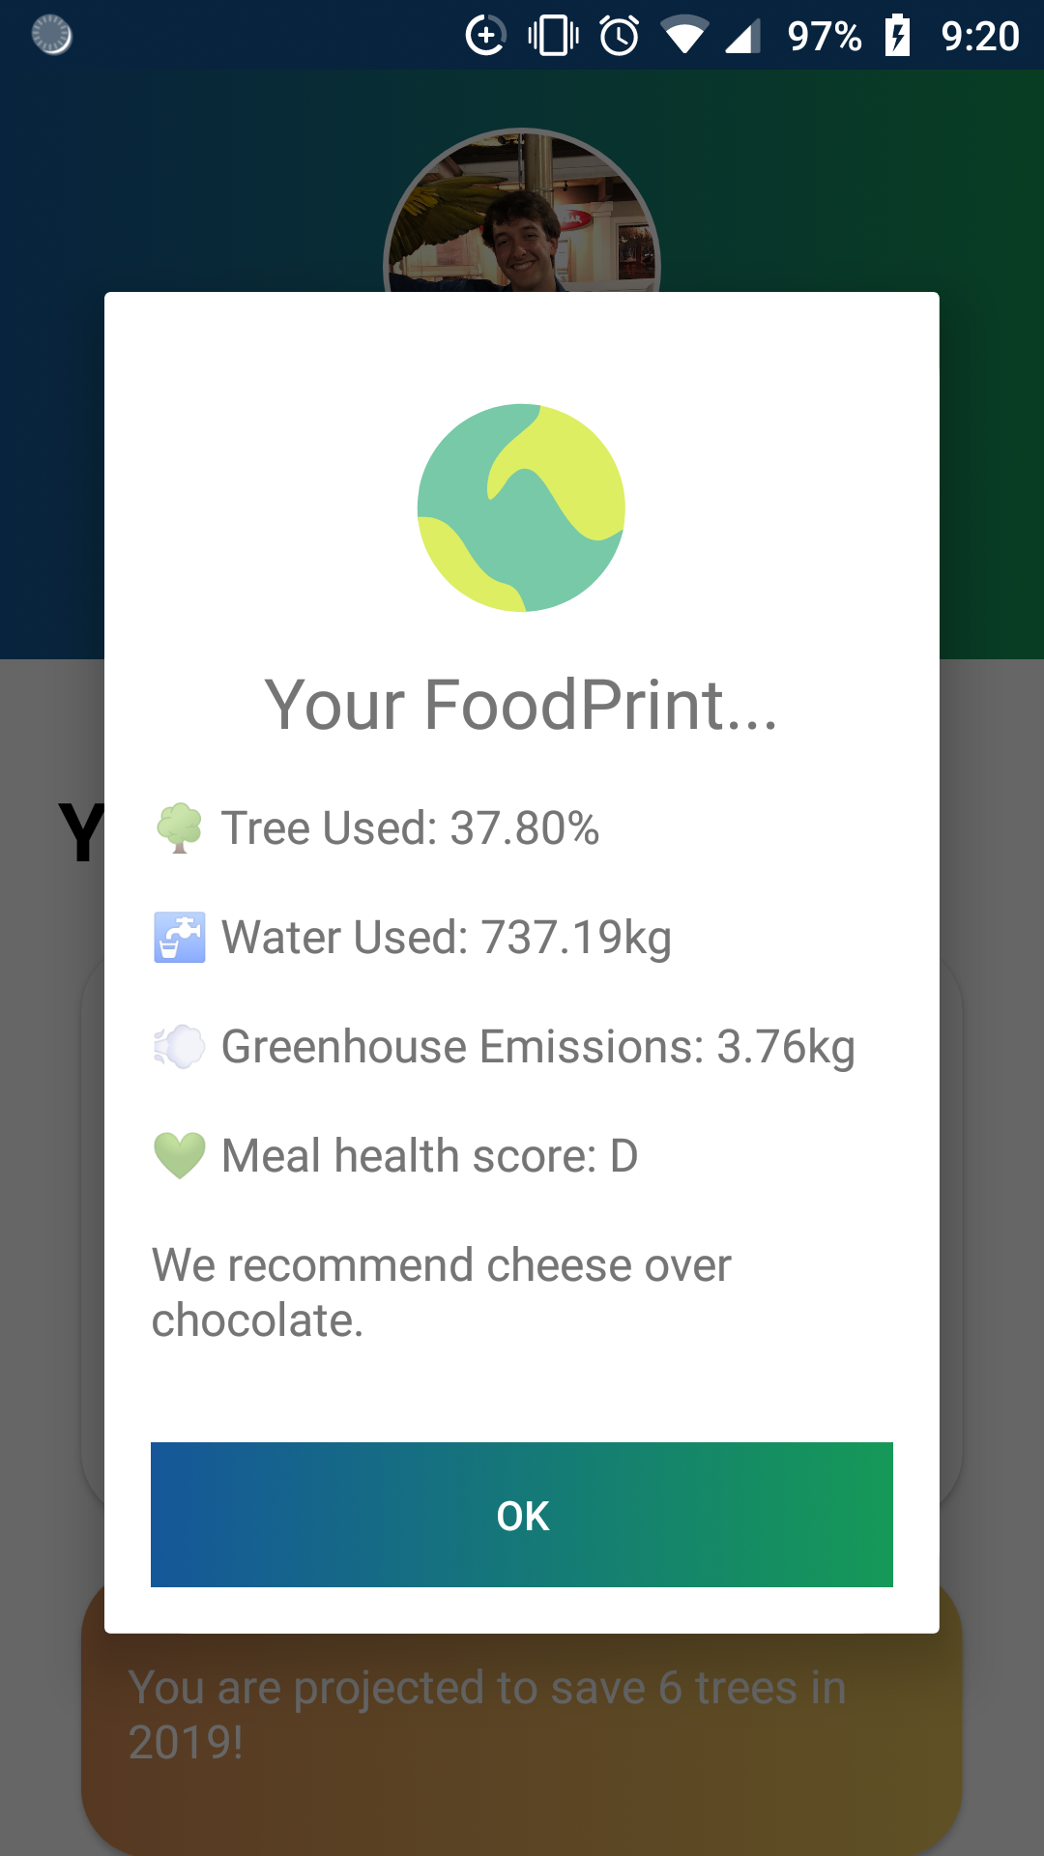
User Interaction through photo-taking
Deep Learning Image Recognition
Evaluation based on nutrition and environmental factors
Personalized Recommendation and Data Tracing

Slide 5

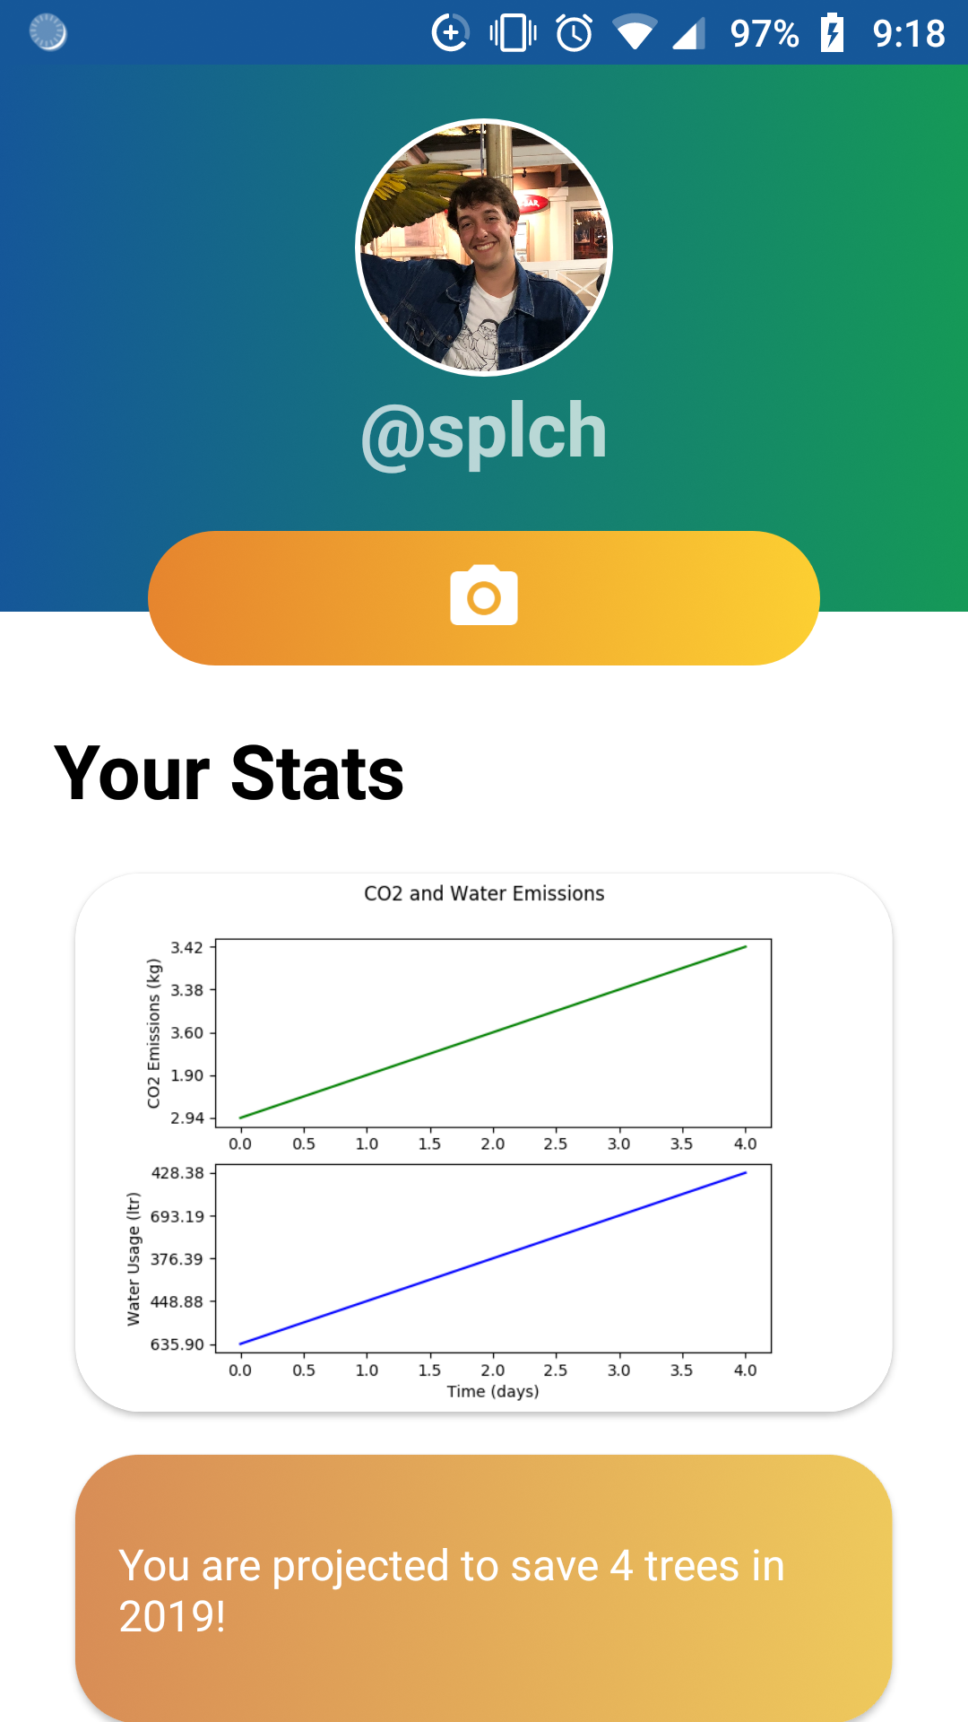
our technology
FOOD IDENTIFICATION
Incorporated an AI model to detect ingredients in our plate and return result to our server
Evaluation and recommendation
How we built it
Developed an algorithm in Python to evaluate the healthiness and environmental impact of a meal and provide recommendations
Data storage and tracking
Incorporated Google Cloud to store and retrieve user historical data for optimal accuracy of foodprint prediction
User interface
Usage of Java and Android Studio

Slide 6
Our impact
Inset your subtitle here. This is a good space for a short subtitle
AND
Short-term Motivation
Long-term Collaboration
Awareness of dietary health
Healthier community
Awareness for environmental change
Cleaner and Healthier Environment
Visualization of personal foodprint
Sustainable practices in the food industry
8.5 Hours

Slide 7
We do Analytics Very Well!
Thank You
Inset your subtitle here. This is a good space for a short subtitle
Notes:
Note: Click on the “Picture Place Holder”, then send the picture back to get the black creamy effect.

